Slide 1
L4/5- Group 8
Thomas Wenman – Group Manager/ Designer
Bailey Keeble – Designer
Ethan Ward - Programmer

Slide 2
Logline
Help banish diseases from infecting a body or nullify the medicines effects by overpowering them.
2 Player
Platform – PC
Genre – Turn based puzzle strategy
Target Audience - Everyone

Slide 3
What does the player do?
Players will fire projectiles towards the enemy lines.
The launcher is effected by how much the mouse is held down and dragged.
Different types of projectiles can be used to allow different scenarios each play.
The goal is to knock the enemy characters into the death zone before they knock yours into it

Slide 4
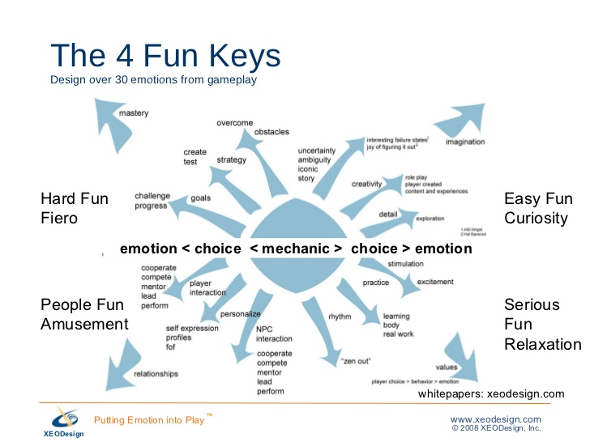
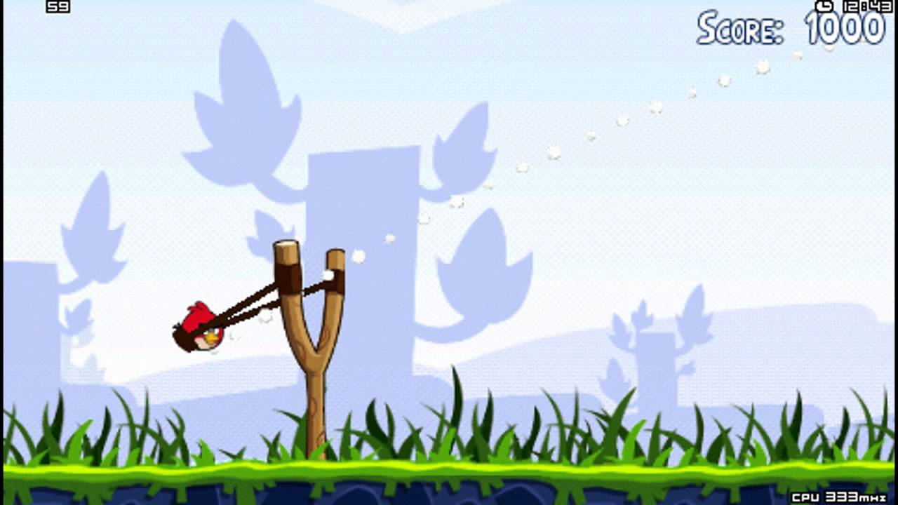
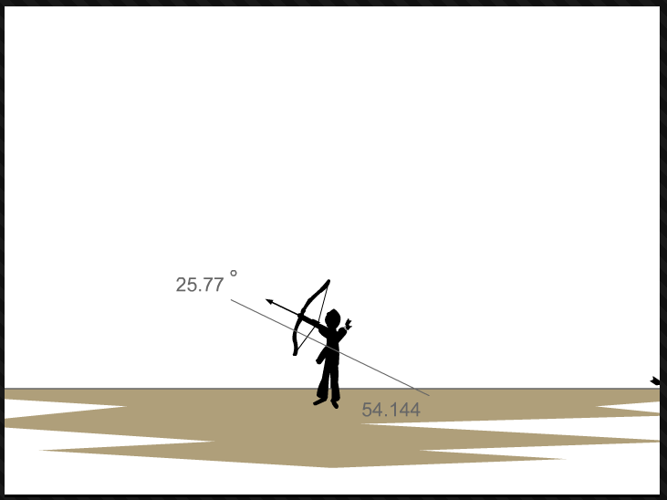
4 keys of fun
Different iterations of the game mechanics will focus on a certain key of fun element.
Feedback from playtesting will be a necessity to focus on this.
Easy fun – Shows last shot
User friendly and can be mastered at any skill
Hard fun – Shots have to be precise.
Hard to master.

Slide 5
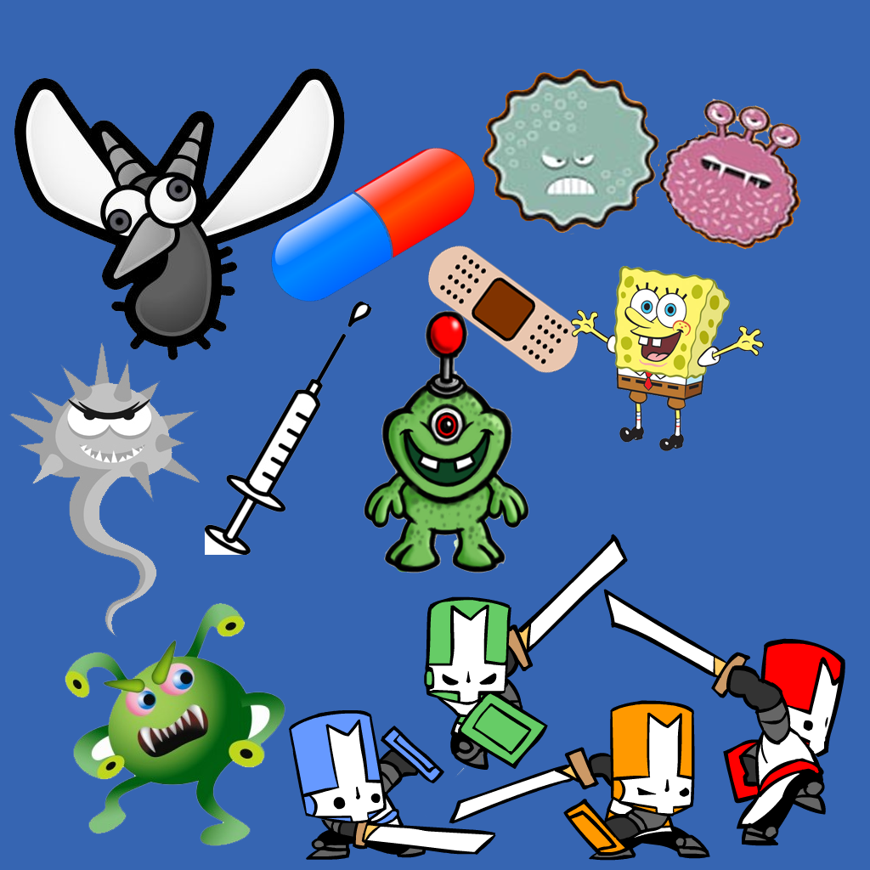
Art style
Art style of choice:-
Cartoon based drawings.
Easier for the designers to create assets as preferred style.

Slide 6
First mechanic: Shooting/Launch
Shows the player the degrees/angle of where the player will shoot
Only shows the player.
Camera follows the arrow
Takes time to master as remembering where to shoot can be a challenge.
Image from Bowman 2
https://www.youtube.com/watch?v=EDxQMLgsJaw&feature=youtu.be

Slide 7
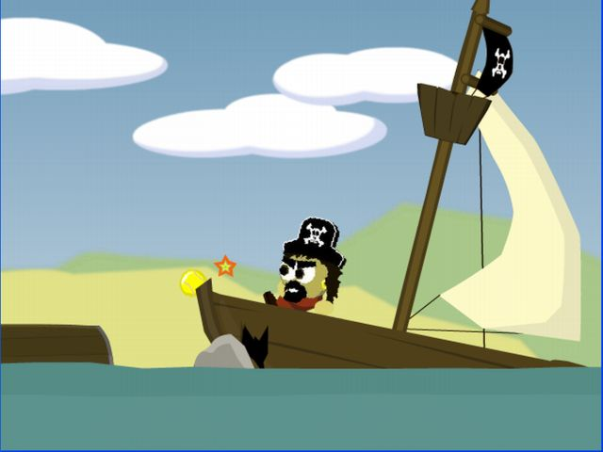
Second mechanic: Collision
Characters/ objects will react to another object colliding with it.
Destroys objects i.e. certain assets
Pushes them with force depending on what was launched.
Object forces character back
Image from: Raft Wars 2

Slide 8
Third mechanic Variants of projectiles
Some projectiles will have different effects during gameplay
Planned projectiles to be added;
One hit projectiles. (Explodes once it hits any collider, deals massive knockback).
Cluster projectiles. (Can hit multiple targets but deals little knockback)

Slide 9
Plans for the future
Create more working prototypes that use different iterations to each mechanic. (i.e. camera follows projectile, camera can see both players in one screen).
Creating unique sprites ready to be put in game.
Add sound effects
Play testing

Slide 10
References
https://aytm.com/blog/research-junction/angry-birds-addiction/
https://image.slidesharecdn.com/fourkeystofunbchislides100n081109-090812123810-phpapp02/95/four-keys-to-fun-baychi-slides-100n081109-9-728.jpg?cb=1250081364
http://www.nicolelazzaro.com/the4-keys-to-fun/
https://www.angrybirds.com/
http://www.miniclip.com/games/raft-wars/en/

Slide 11
Questions?

